Slide 1






CSE445: Machine Learning Project
Project Update
Intelligent AI
Attendance System
Facial & Voice Recognition-Based Attendance Tracking
PROJECT TEAM MEMBERS
Tirtho Majumdar (ID: 2312536042)
Ramisa Anjum (ID: 2232552642)
Md. Rakibul Hasan (ID: 2212346042)
Hafsa Amin Ela (ID: 2131884642)
North South University
Slide 1 of 8

Slide 2



CSE445 ML Project
The Challenge & Our Solution
The Problem
Manual paper-based/roll-call attendance is slow, wasting valuable session time.
Existing physical ID solutions lack accurate biometric verification, making proxy attendance effortless.
Our Automated Solution
Biometric-driven pipeline conducting rapid, contactless detection using facial and voice verification models.
Tamper-resistant tracking reporting directly to cloud database storage logs.
"Enabling seamless, secure and rapid tracking to preserve institutional integrity."
North South University
Slide 2 of 13

Slide 3
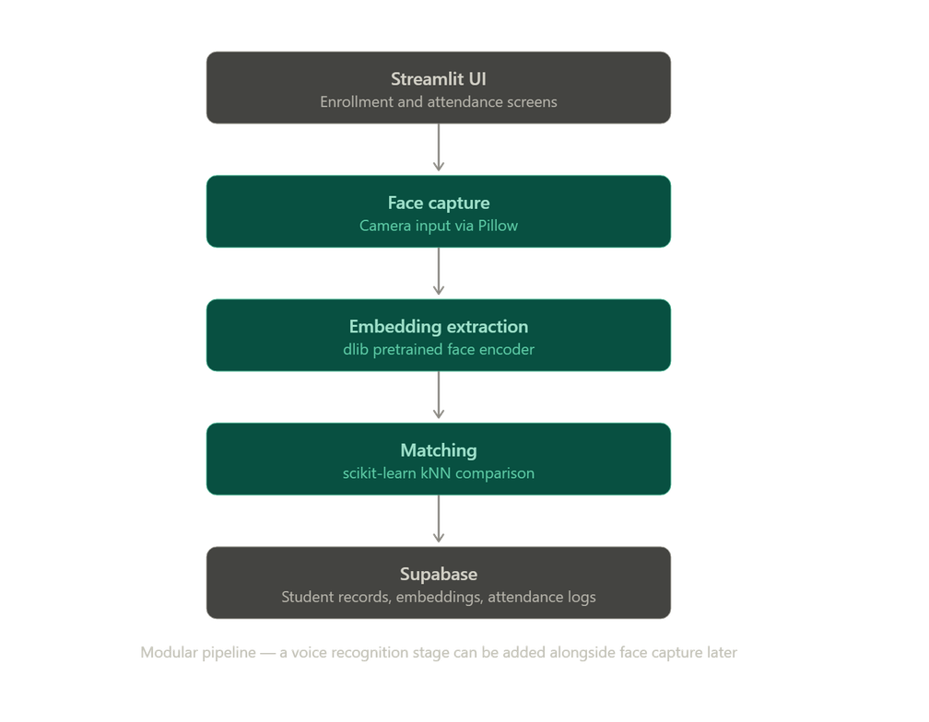




System Architecture
Technical Blueprint
End-to-End Processing Flow
The Processing Pipeline
Streamlit Capture UI
Initiates secure camera frames directly within browser rendering layout.
Embedding Extraction via dlib
Detects facial landmarks, formatting frames into standard geometric embeddings.
Matching & Supabase Logging
Runs verification classifiers and updates logs in Supabase instantly.
Modularity First: Extensible design makes adding independent voice matching nodes seamless.
"Integrated components establishing a robust pipeline from UI capture to DB entry."
North South University
Slide 3 of 13

Slide 4






Research & Conceptual Planning
CSE445 ML Project
Evaluating Models & ML Foundations
Literature Review
ML Metrics & Logic
We contrasted baseline traditional Computer Vision models with state-of-the-art Deep Embedding strategies to evaluate overall utility.
Matching leverages kNN classification pipelines. We prioritize Precision and Recall over simple raw accuracy given skewed dataset structures.
▪
Haar Cascade/LBPH: Unreliable accuracy across standard environment variations.
Precision
Recall
▪
Deep Embeddings (dlib): Yields high consistency metrics even under varying lighting.
Anomalous face vectors are labeled "Unknown" via threshold match rejections.
North South University
Slide 4 of 13

Slide 5






Tech Stack Choices
CSE445 ML Project
Our Operational Tech Ecosystem
Core AI Engine
System Interfaces
Security & Extras
face_recognition (dlib) extracts deep feature embeddings.
Streamlit generates immediate, responsive browser portals.
bcrypt protects database security lines through safe hashing strategies.
Classification matching relies on robust pipelines powered by scikit-learn.
Backend transactions are captured securely using Supabase DB.
segno provides high-speed automated QR code generation tools.
Collaborative Foundation: GitHub repository has been safely configured for continuous deployment tracking.
North South University
Slide 5 of 13

Slide 6

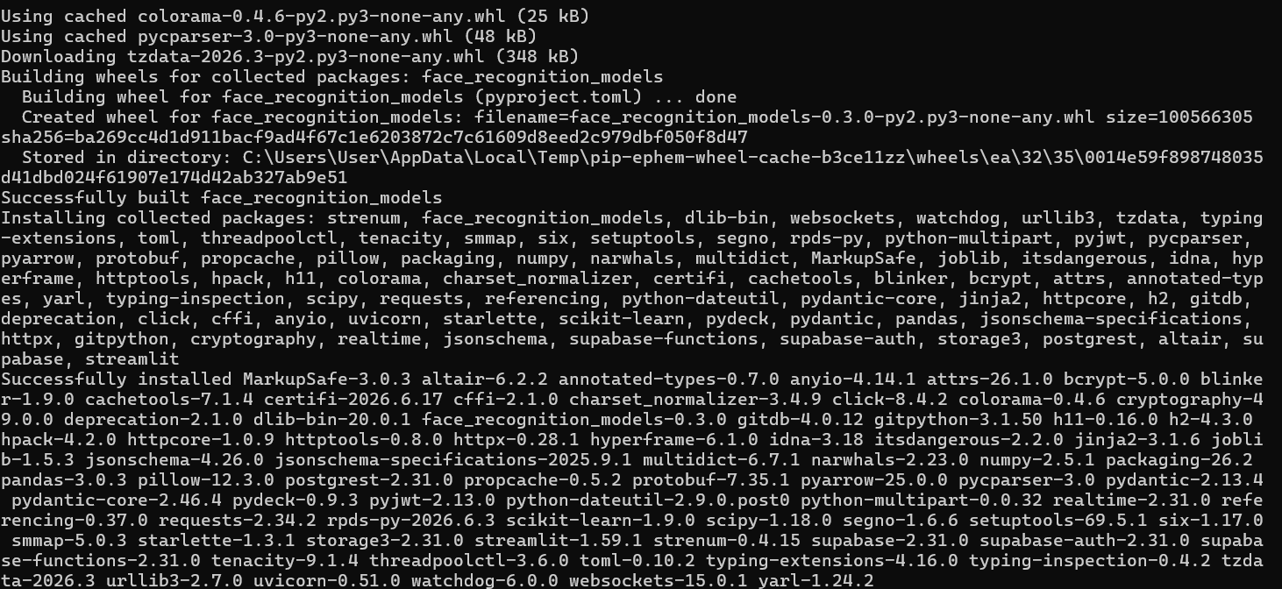
Development Environment
CSE445 ML Project
Environment Partitioning & Assembly
Configuration Steps
Virtual Environments: Established isolated execution nodes preventing local package version clashes.
Requirement Dependencies: Successfully installed crucial processing libraries: numpy, pandas, scikit-learn, dlib-bin, face_recognition, supabase, bcrypt, segno
dlib Setup Resolution: Overcame specific C++ compilers/CMake building system issues by leveraging localized binary compilation paths.
Installing all the dependencies from the requirements
North South University
Slide 6 of 13

Slide 7

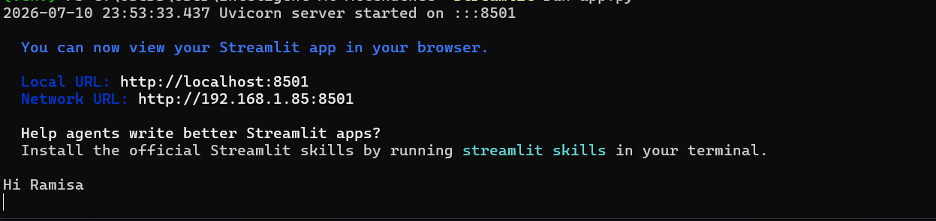


Application Verification
CSE445 ML Project
Initial Prototype Verification
Basic Application Testing
Streamlit App Base Verification: Developed baseline user interfaces tracking core state reactions.
Import & Render Check: Validated full import execution safety paths across runtime sequences with zero environment faults.
Version Control Updates: Safely pushed core configurations and initial setup directories to master repository branch.
"Verifying local app deployment structures before expanding modular verification algorithms."
North South University
Slide 7 of 13

Slide 8
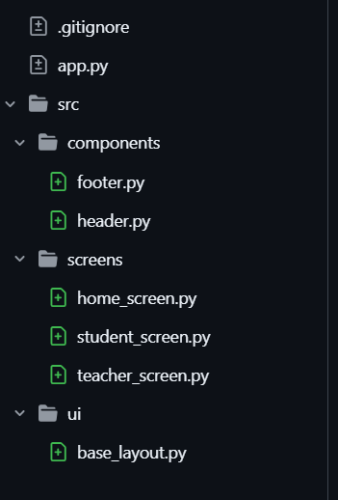
Architecture Upgrade
CSE445 ML Project
Modular Structure & Portals
Structural Re-engineering
Modular `src/` Package: Refactored the single monolithic file structure into isolated packages: `components/`, `screens/`, and `ui/`.
Enhanced Landing Home: Developed a unified `home_screen()` housing portals for students and teachers through clean mascot-branded blocks.
Role-Based Routing: Configured session security routing using native Python pattern matching (`match/case`) on authentication states.
SnapClass Brand Identity: Styled design schemes and structured navigation elements with consistent branding.
The modular structure
North South University
Slide 8 of 13

Slide 9

Reusable UI Elements
CSE445 ML Project
Core UI Assembly & Themes
Design & Layout Advancements
Shared Page Shells: Segmented layout definitions inside specialized modular script units (`header.py` and `footer.py`).
Typography Identity: Standardized custom branding configurations under ‘base_layout.py’.
Immersive Theme Shell: Removed defaults like standard top margins to offer users a tailored native dashboard wrapper.
Structural Placeholders: Established operational placeholders for screen actions inside the newly structured screens module.
Homepage design
North South University
Slide 9 of 13

Slide 10
Technical Challenges
CSE445 ML Project
Technical Obstacles Overcome
System Bug Resolution
dlib Environment Faults: Encountered native environment compiler blocks; circumvented by leveraging local bin setups.
Malformed Nested Blocks: Resolved an unclosed rendering layout in the dashboard shell headers that had mixed container tags.
Defective Logo Paths: Identified broken unhosted static image strings in the footer configurations; corrected to safe cloud references.
Portal Screen Equivalence: Addressed identical initial routes inside secondary views to preserve logical system flow.
North South University
Slide 10 of 13

Slide 11










Next Milestones
CSE445 ML Project
Project Implementation Roadmap
Forward Planning Activities
Resolve
Implement
Integrate Cam
Accuracy Audit
Voice Authentication
Patch the remaining broken structural references and correct all nesting bugs.
Expand functional operations inside the student and teacher workspace screens.
Feed camera capture streams into local deep embedding models for matching.
Evaluate performance benchmarks using precision and confusion matrices.
Determine practical limits of adding secondary vocal signature verification pipelines.
01
02
03
04
05
North South University
Slide 11 of 13

Slide 12

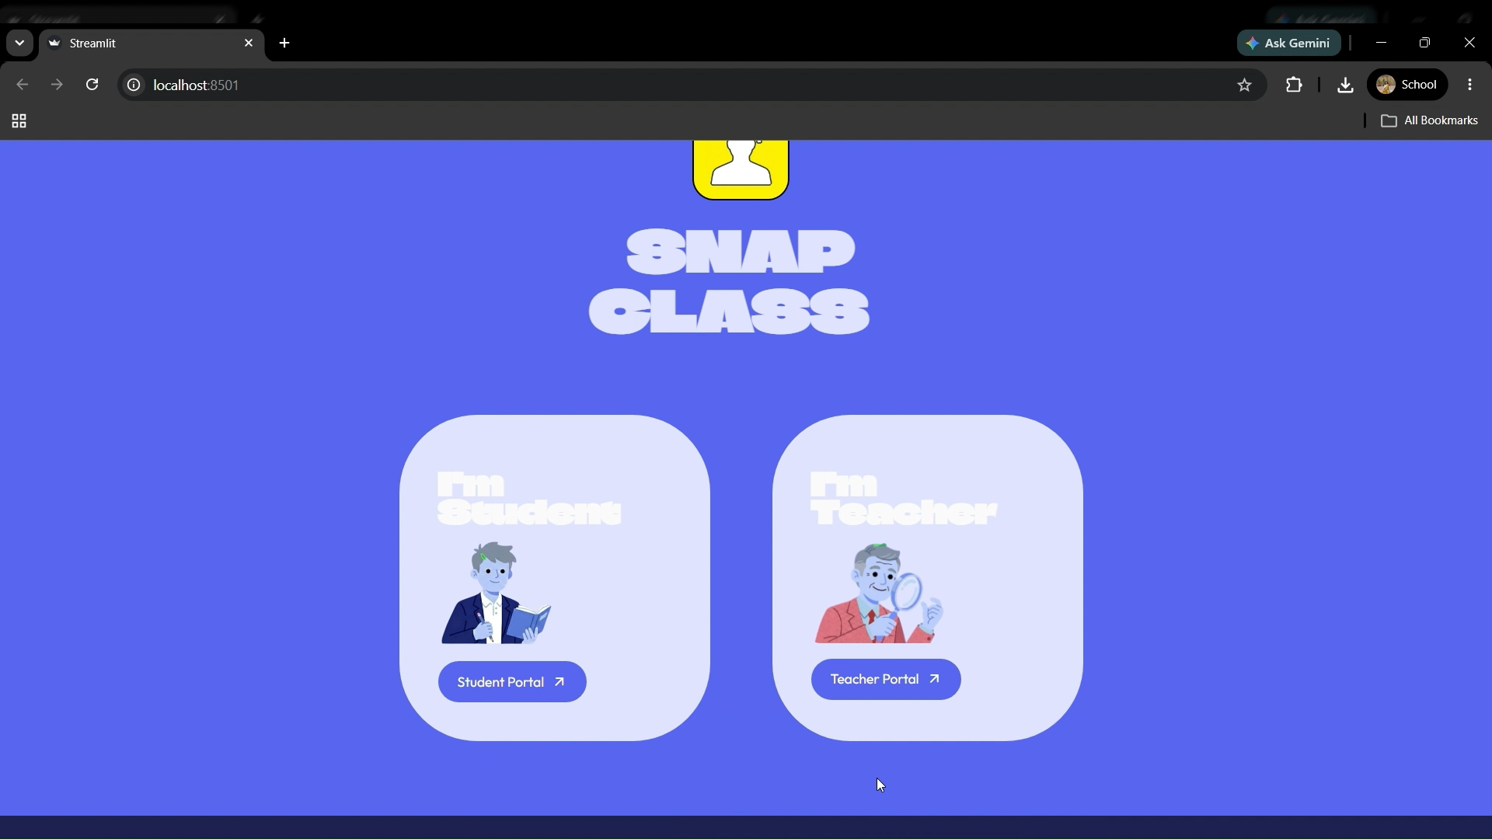
App Walkthrough
CSE445 ML Project
App Interface Overview
"Interactive application demo of the complete SnapClass portal architecture."
North South University
Slide 12 of 13

Slide 13
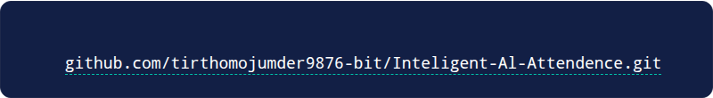

Project Update
CSE445 ML Project
Thank You
Intelligent AI Attendance System Progress Presentation
GITHUB REPOSITORY LINK
Course Code: CSE445 Machine Learning
North South University

